Slide 1
Watering System

Slide 2
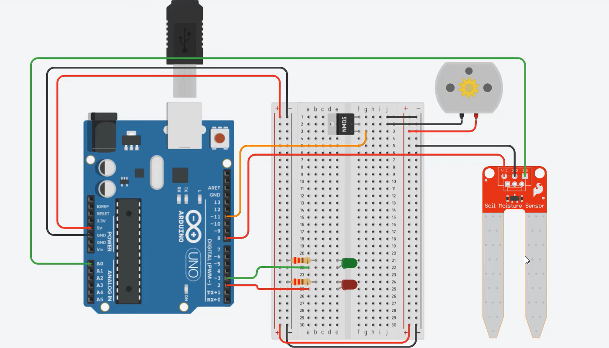

Slide 3
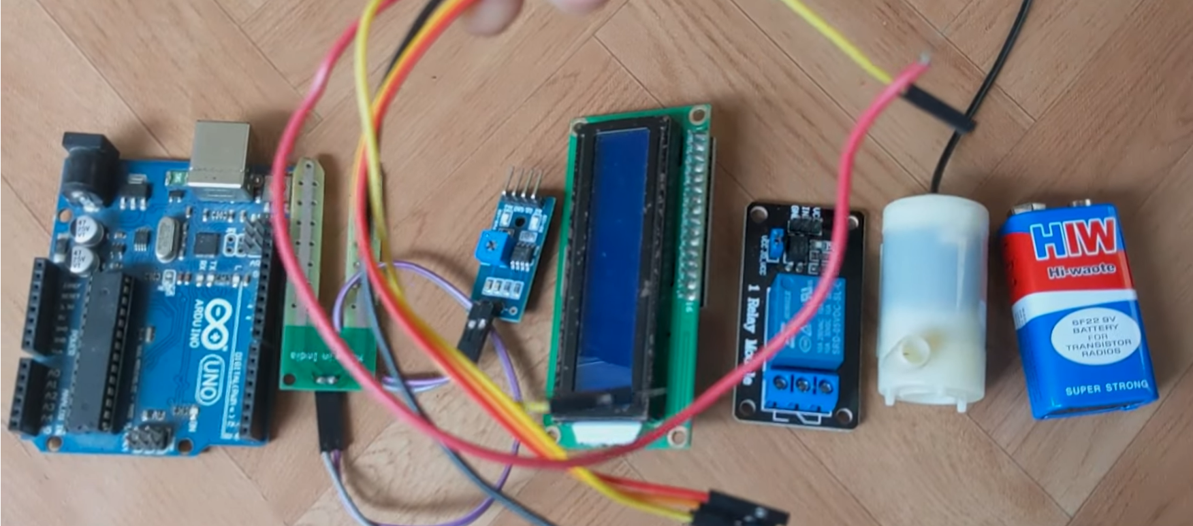

Slide 4
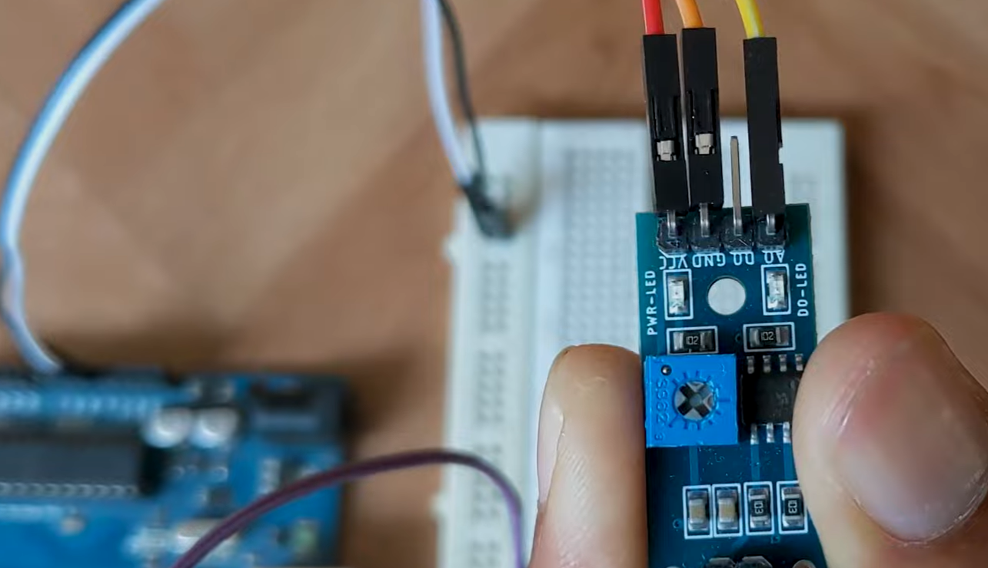

Slide 5
From Water Sensor
VCC → 5v
GND → GND
A0 → A0
From Display
VCC →
GND → GND
HDA → A4
SCL → A5

Slide 6
RELAY Module
VCC – 5v
GND – GND
IN1 – Pin 7

Slide 7
Pump
Negative terminal (black) of the pump → Negative terminal of battery
Positive from Battery goes to → Middle of relay
Red from Pump goes to the outer pinon relay

Slide 8
